Slide 1
The Battle of Neighborhoods
Capstone Project
-Shalaka Hegde

Slide 2
Germany
Germany constitutes of 16 federal states.
Each state has its own constitution.
Germany has a social market economy with a highly skilled labour force and has the largest national economy in Europe which is also the world's fourth largest by nominal GDP

Slide 3
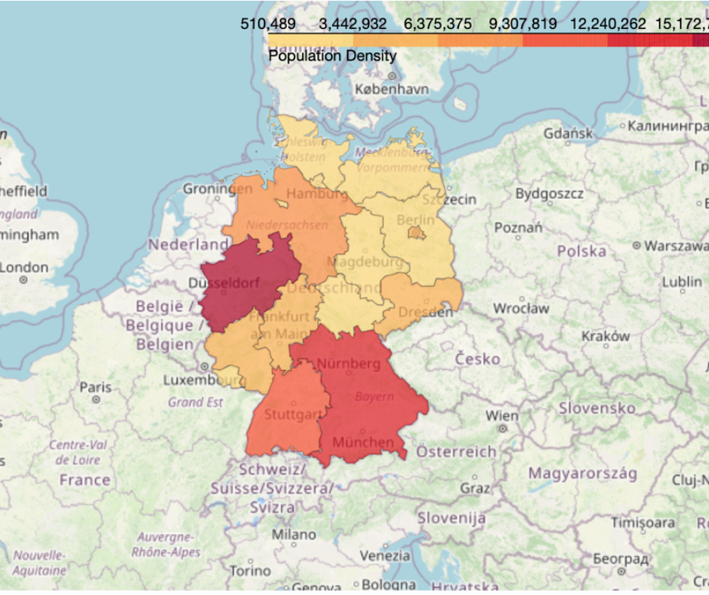
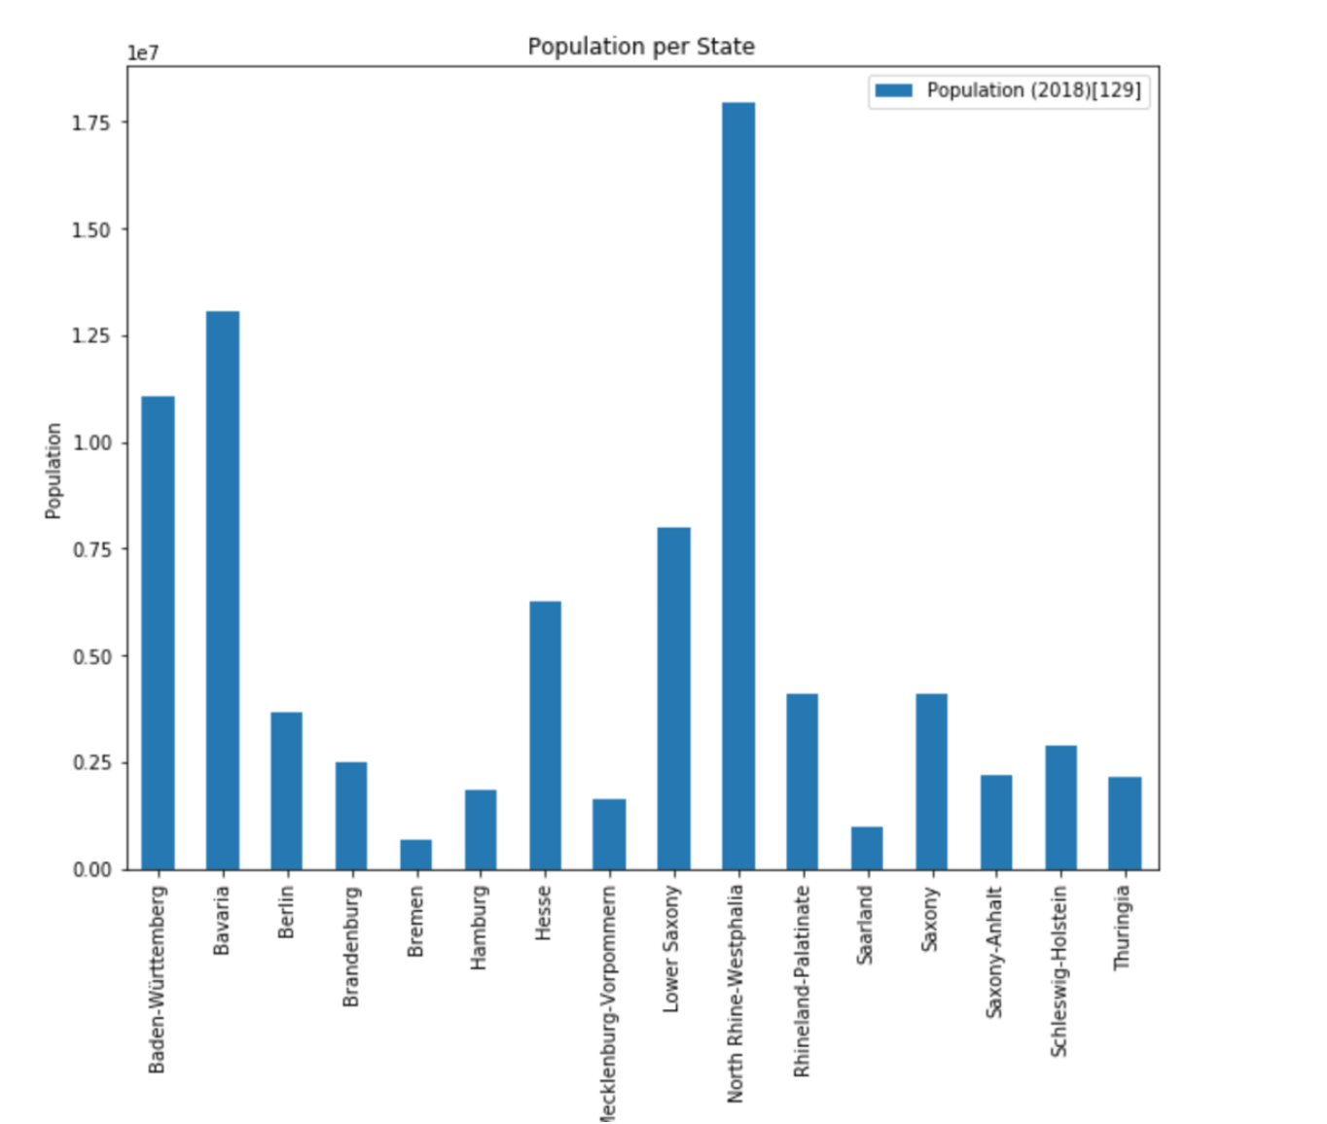
Population
First, we take a look at the population per state wise in the country

Slide 4
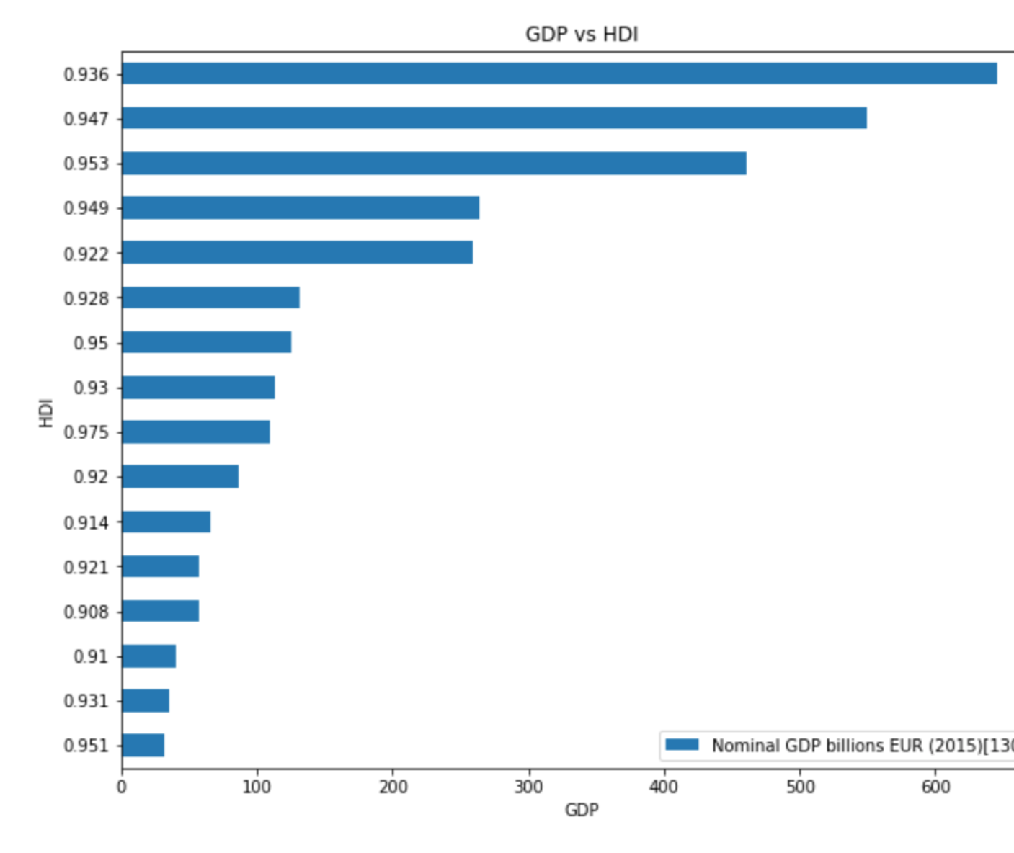
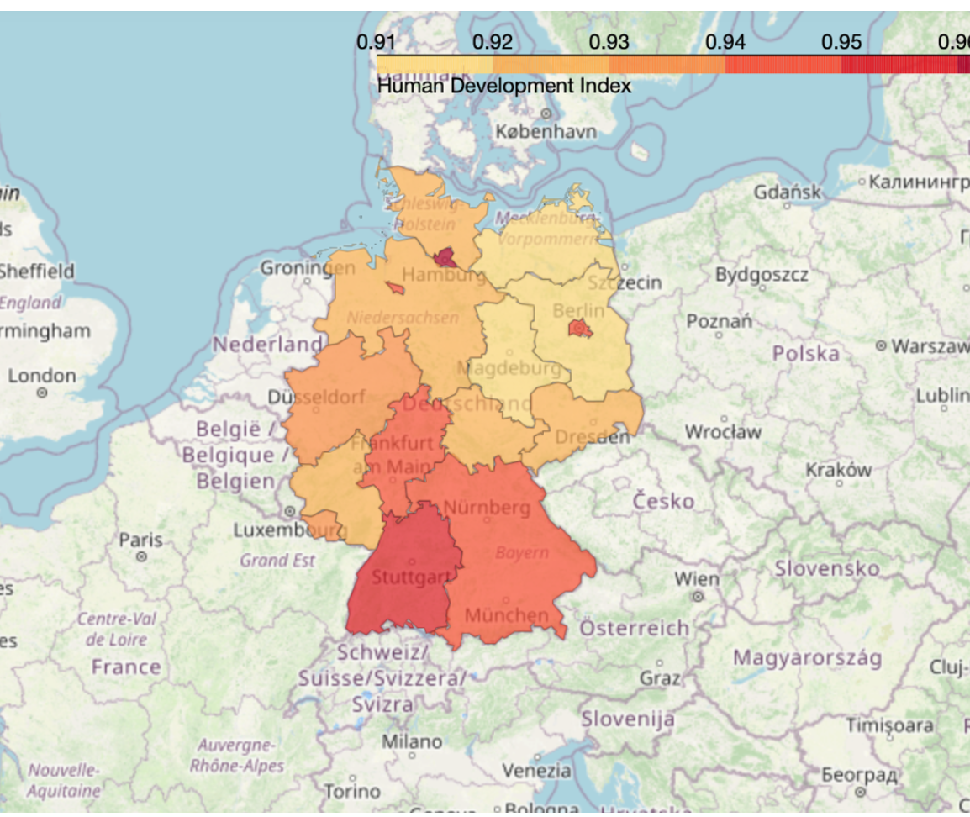
Gross Domestic Product vs Human Development Index

Slide 5
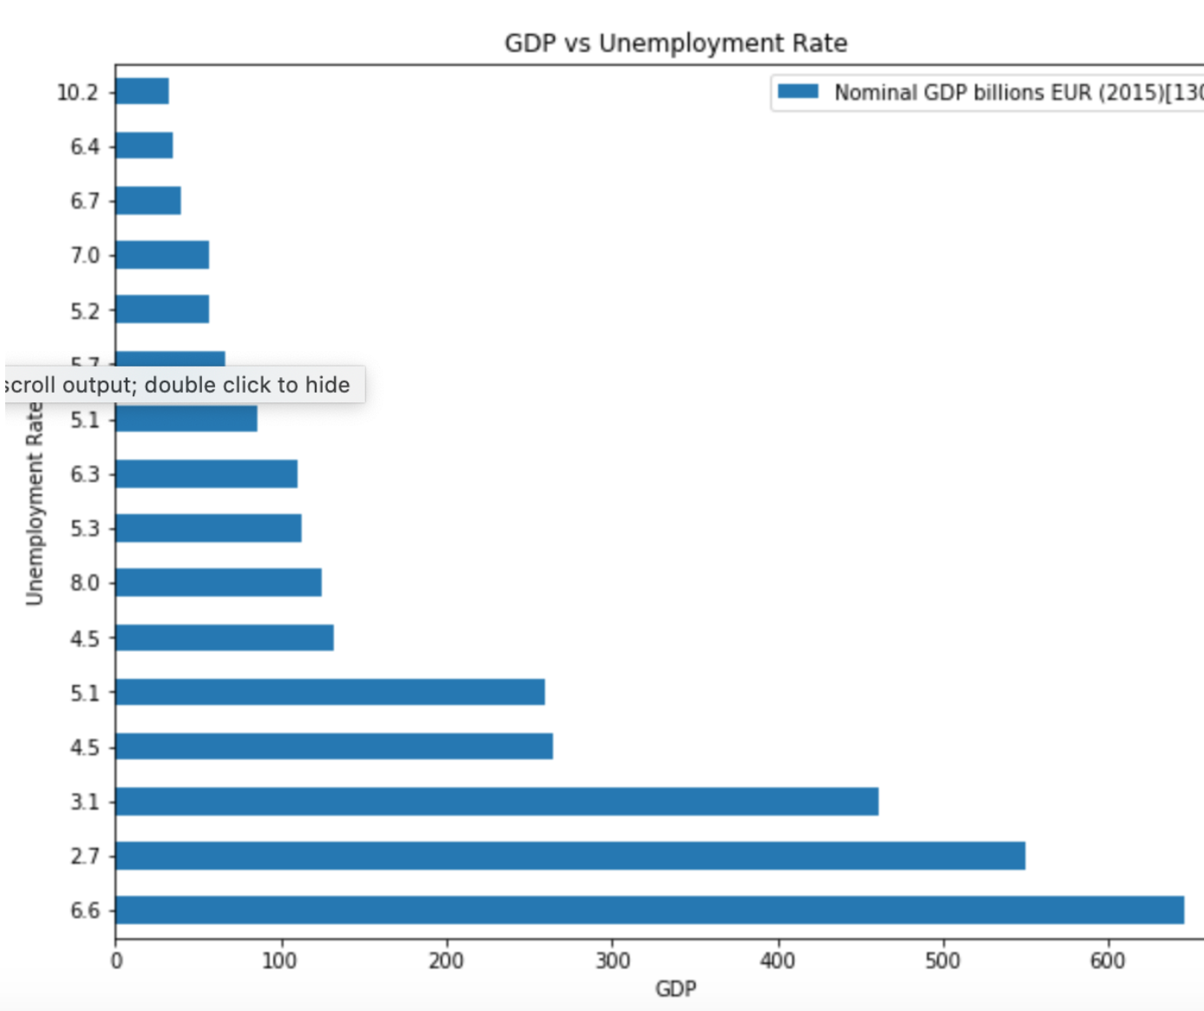
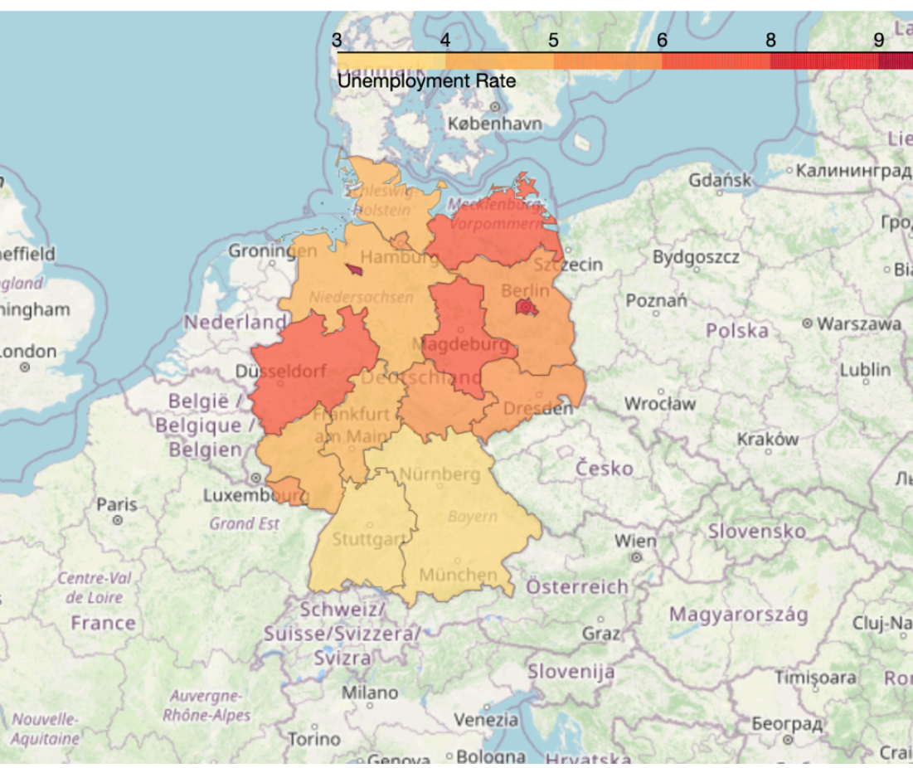
Gross Domestic Product vs Unemployment Rate

Slide 6
Conclusion
In this study, we can analyse the Demographic and Economic effects as well as the Human Development with respect to these factors.
The analysis are useful to understand and study the growth of the country.

